Slide 1
From Potential to Prosperity Part 2 –
3 Strategies & 5 Sectors to Drive Diversification
2nd Competitiveness Forum Suriname
March 12th, 2015

Slide 2
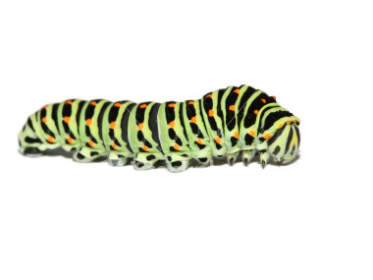
Converting Potential into Prosperity
How do we drive Suriname’s metamorphosis?
2

Slide 3
Rapid Diagnostic
Thanks to extractive industries, per capita GDP growth is strong
1975 – 1987
Per Capita GDP Growth Rate = -2.20%
2001 – 2012
Per Capita GDP Growth Rate = 4.10%
1988 – 2000
Per Capita GDP Growth Rate = -0.03%
Post-independence adaptation
Political transitions
Dependence on Dutch financial assistance
Economic Stagnation
Democratic elections established
Preliminary implementation of economic diversification
Dutch development funds frozen
Decline of the mining, construction and utility sectors
Growth based on extractive sectors
Sound monetary and fiscal policies
Strong commodity prices
3

Slide 4
Rapid Diagnostic
However, this growth has not been shared equally…
Suriname is a regional economic growth over-performer and an equality underperformer.
Equality & Decline
Equality & Growth
How?
Avg. Gini = 49.52
Disparity & Decline
Disparity & Growth
Avg. Growth % = 3.06%
= $100 Billion GDP 2013 (Current $USD)
Source: World Economic Outlook Database of the IMF, May 2014; Quandl Gini Coefficient Database 2014
4

Slide 5
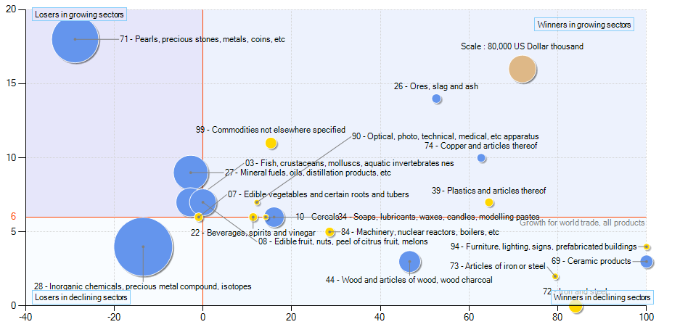
Rapid Diagnostic
…and future growth is threatened by declining market shares
Suriname is currently losing global market share in its two largest export sectors, and is heavily weighted in the globally declining sectors of Inorganic chemicals, precious metal compounds & isotopes
Growth of national supply and international demand for export products of Suriname - 2012
Annual growth of world imports between 2008 – 2012, %
Annual increase of Suriname share in world exports between 2008 – 2012, %
Suriname must re-balance its sector portfolio away from a natural resource-based economy
Source: Trademap Data, 2014.
5

Slide 6
Rapid Diagnostic
Moreover, a reliance on natural resources leaves nations poor
Natural Resource Rents as % of GDP compared to purchasing power, 2012
Countries that are dependent on natural resources tend to have the weakest revenues per capita
Source: WDI, 2014.

Slide 7
Moving from today to tomorrow
The beginning of a transformative process…
Suriname Today:
Heavy dependence on commodity exports
Limited innovation and new product development
Product based economy
Growing inequality
The Upgrade Process
Customer & demand driven.
Active participation from the public & private sectors.
Shared Vision
Suriname Tomorrow:
Diversified, sustainable export-led economy
Skilled workforce & specialized training
Constant learning, innovation
Increase in services
Prosperity for all
7

Slide 8
Moving from today to tomorrow
An iterative process leveraging data + “wild cards”
80% structured brainstorming leveraging TradeMap data…
… combined with 20% “crazy ideas” to ensure nothing is overlooked
Suriname’s Current Export Basket
Regional Peer Export Basket
Global & CARICOM Import Markets
8

Slide 9
Upgrading Suriname’s Export Sector
Achieving growth via making difficult choices
In order to upgrade Suriname’s export sector, we must make difficult choices, assisted by a clear and streamlined process.
Identify 6 products at 4 or 6 digit HS code level
Prioritize & Validate 10 Clusters
HS 2-digit level
Long List of Clusters
HS 2-digit level
100+ Clusters
Develop long list of ~20 products at 4 or 6 digit HS code level
Where we are now
Process:
Build database of all priority clusters at 2-digit level, including products and services
Resources:
TradeMap
Process:
Collect and process data around peer country & Suriname Exports, Imports, Growth for each cluster
Clean datasets and assign ranks
Eliminate outliers (too sophisticated, re-export, etc)
Build prioritized list from what Suriname can improve, and from new opportunities
Validate choices with stakeholders
Resources:
TradeMap
Stakeholder Consultations
Process:
Based on validated cluster groups, build database of products at either 4 or 6-digit HS code level
Eliminate outliers
Resources:
TradeMap
Process:
Decision maker consultations
Product Sophistication
Employment / Outreach calculations
Resources:
Stakeholder Consultations
TradeMap
WDI
FAOSTAT
COMTRADE
UNIDO
In this process, we move from broader buckets and categories to more specific products, making tough choices along the way
9
Notes:
Build long list of clusters
Prioritize 10-15 clusters based on xyz
Develop long list of products at 4-digit or 6-digit code level
Use the following to widdle down to 6 prioritized products

Slide 10
A Targeted Set of Export Niches
Top 20 Products/Services from Shortlisted Clusters
Byproduct of refining, so not likely to create additional private sector activity.
Suriname’s growth requires the strengthening emerging export products and moving stable products toward sophistication.
10

Slide 11
A Targeted Set of Export Niches
Unveiling Winning Products
The attractiveness of clusters are often driven by a select few products with growing global demand and relative sophistication.
11

Slide 12
The Solution
1 – 3 – 5 to Drive Diversification
1
Vision
A diversified, prosperous and competitive Suriname
3
Cross-Cutting Strategies
Deepen trade with the Netherlands
Open the US Market
Create Shared Value in the natural resource sectors
5
Export Niches
Fish
Wood
Tourism
Gold (Shared Value)
Vegetables

Slide 13
The Solution
3 Cross-Cutting Strategies to Drive Export Growth
1
Deepen trade with the Netherlands. Increase export share via more volume and higher value products.
2
3
Create Shared Value in the local mining sector. Investment into local supply chains could reduce imports and increase the value of services to the large mining operations.
Open the US market. Neighboring countries have significant exports to the U.S. while Suriname has almost none.

Slide 14
A Targeted Set of Export Niches
Our preliminary recommendation
Source | 2 Digit Cluster | 4 Digit Products | Rationale
TradeMap Analysis | Fish | Crustaceans Whole fish Fish fillets | Solid current performance ($70 million) Huge upside potential in new and existing markets (only 3% of Netherlands crustaceans market at ½ the price point)
 | Wood | Wood in the rough Sawn Carpentry / joinery | Massive renewable resource Value add potential
 | Tourism | N/A | Among the largest of diversified exports Huge upside potential based on untapped markets & regional performance
 | Gold (Shared Value) | Unwrought or semi-manufactured forms. | One of the largest current export sectors $1 billion investment by Newmont Currently limited value add.
Wildcards | Vegetables | Fresh or chilled Frozen | Small current exports (<$5 million) However, new investment coming online

Slide 15
Suriname’s Opportunity in Wood
A potential migration strategy
‘4418
Builders’ joinery & carpentry
‘4407
Wood sawn / chip
Suriname’s Current Avg. Export Value / Ton ($USD)
‘4403
Wood in the rough
Sophistication (PRODY)

Slide 16
Building competitive sectors Burundi has the potential to build a transformative fish sector
Impact des Actions Prioritaires sur les revenus de l’industrie de peche du Burundi en millions de USD (2015-2020)
More high quality fish
Increase production
Sell to new markets and reduced wastage
Value addition
Source: Les estimations sont basées sur l’analyse ESPartners, Mai 2014

Slide 17
Moving from Analysis to Action
The 5 Pre-Conditions for Change
The 5 Pre-Conditions for Change
Common Objectives
Do leaders have shared understanding of success at the national or sectoral level?
Is there any urgency for change?
Tension
Is there strong leadership in government, the private sector & “others”?
Leadership
Are leaders receptive to ideas & advice from outside?
Does the knowledge exist to achieve this vision?
Receptivity
Insight
Is Suriname ready for change? If not, what are the levers to foster these conditions?
17

Slide 18
Conclusion + Q&A
THANK YOU!
From Potential to Prosperity Part 2 –
3 Strategies & 5 Sectors to Drive Diversification
Rob Henning
rhenning@espartners.co
Eric Kacou
ekacou@espartners.co

