Slide 1

From Potential to Prosperity
Five Imperatives for Transforming Suriname’s Economy
March 12, 2015

Slide 2
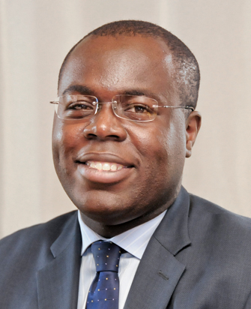
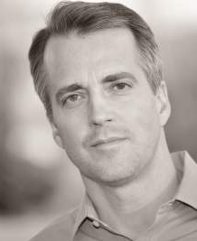

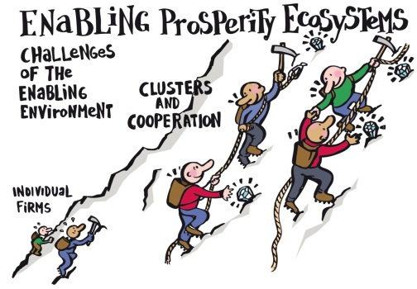
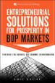


About ESPartners
Entrepreneurial Solutions for Prosperity
What we offer
Selected Team
Intelligent Capital™
Prosperity Ecosystem™
Eric Kacou
Co-founder & CEO
Rob Henning
Co-founder & Partner
Intellectual Foundations
Archimedean Leadership™

Slide 3
















ESPartners’ Experience
We have collaborated with 15+ clients in 20+ countries
Selection of Experience Sectors & Clusters
Agri-business Financial Services Petro Chemical Dried Fruits & Nuts Forestry Products Aquaculture Artisanal Tourism Pisciculture Wealth Management | Horticulture NTIC Distribution Sugar Textile Manufacturing Distribution Events & Music
Relevant Experience
Selection of Experience: Countries
Côte d’Ivoire Rwanda Burundi Congo Gabon Mali Angola South Soudan South Africa | Nigeria Haiti Afghanistan Bermuda Jamaica Bangladesh USA Canada France

Slide 4
ESPartners’ Experience
A Global Leader in Competitiveness
ESPartners Product Lines & Geographic Focus
ESPartners is a boutique investment and strategy consulting firm that serves a range of public and private sector clients in emerging markets. We seek to create prosperity in some of the world’s most challenging economies by unleashing the power of Intelligent CapitalTM, or the right mix of capital & insights, to foster equitable & sustainable growth.
Select Experience in National Competitiveness & Private Sector Development Projects
Project Name | Country | Year | Funding | Project Description
Anchor Points Project Design | Haiti | 2013 - 2014 | IDB | The IDB selected ESPartners to identify and vet high-priority agricultural and tourism anchor companies in Haiti, as part of a strategy to drive regional agricultural , tourism and economic growth.
Haiti Economic Recovery Roadmap (ERRM) | Haiti | 2010 | USAID | In the aftermath of the 2010 earthquake, the GC requested that ESPartnerscontinue their work with the GC to develop a detailed action plan for economic recovery. The plan identified $1.4 billion in investments with the potential to create 1 million jobs in five priority value chains.
Shared Vision for a Competitive & Prosperous Haiti | Haiti | 2009 | IDB, USAID & AmCham | With the support of international partners, the Presidential Working Group on Competitiveness (GC) we facilitated a process to develop a national Shared Vision to put Haiti on the road to competitiveness and prosperity. This engagement consisted of rigorous cluster and value chain analysis accompanied by a participatory process to achieve buy-in to the process, as well as a mental models analysis.
Rwanda National Innovation & Competitiveness Project (RNIC) | Rwanda | 2002 - 2010 | Government of Rwanda | ESPartners and its team led the transformational RNIC for nearly 10 years. Specifically, they oversaw a range of advisory services such as research, analysis, market surveying and mental models technology; the development of ongoing collaborative ‘clusters’ or working groups; and support to implementation in a range of industries and institutions.

Slide 5
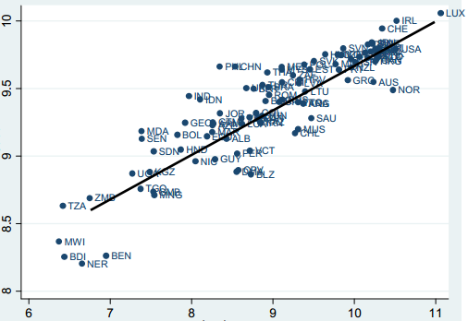
Our Approach
“We are what we export”
Correlation between the complexity of the export basket (Log EXPY) and per capita GDP
Complexity of the export basket (Log EXPY)
GDP per capita (log PIB PPP)
Note: En abcisse, le log. du PIB réel per capita (PPP) et en ordonnée le log. de l’indicateur EXPY (PPP). Source: HAUSSMANN

Slide 6
Transforming Potential into Prosperity
What is the Next Stage in Suriname’s Economic Transformation
Private Sector Leadership
High
Build a platform for core processes and products
Choosing Customers and Markets
Defining Distribution Channels
Investing in Employees
Sell Products
ECONOMIC LEADERSHIP
Stable Macroeconomic environment
Rule of law
Allocation of Resources
Exploit Raw Materials and Cheap Goods
Government Leadership
Low
Low
High
ABILITY OF THE ECONOMY TO SUSTAIN COMPLEX RELATIONSHIPS
Physical Capital
Social Capital
Developing countries must invest rents from selling physical capital in creating the higher Forms of social capital required to develop and sustain a complex economy

Slide 7



A Successful Metamorphosis
The origin of Butterflies

Slide 8
A Successful Metamorphosis
The origin of Butterflies
Embrace National Change
Build Great Products through Clusters
Mind the Iceberg
Change Mindsets
Collaborate to Compete

Slide 9
Imperative 1—Embrace National Change
Rwanda Vision 2020
Rwanda GDP Objectives 2000- 2020
GDP Growth
Rwanda’s economy will need to grow 7-fold in order to reach Vision 2020 $900 per capita income
2020 GDP is $14.4 Bn
Rwandan Population (000)
2000 GDP is
$2 Bn
Population Growth
$900 per cap
Most demographic forecasts assume a continued annual growth rate of 2.5-3% in the next 20 years
At that growth rate, Rwanda's population will double to 16 million by 2020
Despite possibilities to influence family planning, economic objectives should assume higher-end demographic projections
$250
$900

Slide 10
Imperative 1—Embrace National Change
Mindsets, Clusters and Partnership
Mental Models
Strengthen competitiveness culture
National, industry-wide, or firm-level surveys to understand leaders’ attitudes towards competitiveness
Communication campaign to
address leaders’ attitudes about competitiveness-includes seminars, workshops, presentations, books & articles, lectures
Shared competitive mindsets and sound macroeconomic environment
Cluster Strategies
Build competitiveness of key industries / clusters
Identify key industries / clusters
Apply 5-step process to develop cluster strategies and plans
Quantify costs and returns of competitiveness strategies
Draw operating plans and assist implementation
Transform domestic economy’s performance by building the competitiveness of wealth-creating Industries / clusters
Objectives
Public-Private
Partnership
Enterprise
Development
Build companies’ internal capacity
Government Support
Strengthen enabling environment for private enterprise
Activities
Results

Slide 11
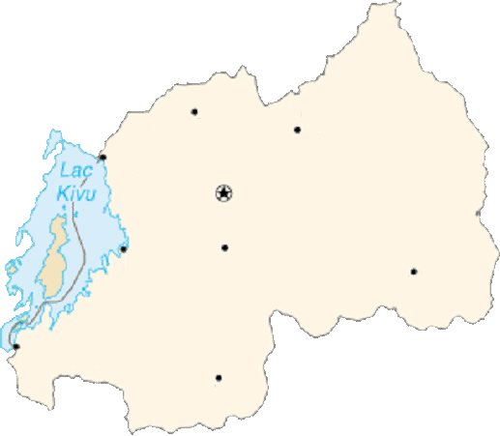
Imperative 2—Build Great Products through Clusters
High value and low impact Primate Experience
Rwanda’s Product to Eco-travelers
“The Primate Certification Course” Experience
Who are the Eco-travelers?
Seasoned travelers, Eco-travelers travel the world looking to experience life-defining nature-based activities with a strong scientific ‘feel’. Instead of thinking about a specific country, Eco-travelers select from an activity menu to construct their trip around some of world’s rarest natural species and sites. Prior to the trip, they spend significant time researching both the attraction and the destination. Although interested in the occasional “adrenalin rush” experience, Eco-travelers want to travel in totally safety. They also want to add texture to their magazine or book based on knowledge about the species they are interested in—the more sights, sounds and smells, the better! This mix of needs make Eco-travelers look for fully insured tour companies operating high quality equipment and great guiding and interpretive services. Ecologically and culturally sensitive, Eco-travelers want to be “non-intrusive” and leave nature intact. Therefore, Eco-travelers seek comfortable lodges to stay in communion with nature
Day 6-8— Ruhengeri
Meet Diane Fossey scientist at Karisoke camp, and have quick orientation session
Spend night at community-run lodge- 1st trek in the morning- class in the afternoon
Intore dance at night- 2nd trek in the morning- departure in the afternon
Day 5-6 — Kibuye - Gisenyi
Travel to Kibuye by boat—lunch, afternoon at the spa, night at the guest house
Travel to Gisenyi by boat- lunch, visit local farms, and travel by road to Ruhengeri
Ruhengeri
Byumba
Gisenyi
KIGALI
Day 1— Kigali Arrival
Meet certified guides
Go through visit schedule
Reading material handed out
Kibuye
Kibungo
Nyanza King Palace
Cyangugu
Day 2 & 4—Nyungwe
Travel to Nyungwe- safety, food, dress code tips
Stay at great local lodge, classes, and treks through the forest to see chimps, baboons, and other rare species
Butare
National Museum

Slide 12
Imperative 2—Build Great Products through Clusters
The 5-Step Process
Step 1
Step 2
Step 3
Step 4
Step 5
Analyze Current Situation
Set Industry Objectives
Understand Customer Needs
Articulate Competitive Positioning
Develop Action Guidelines
Formation and Ongoing Participation of the Cluster Workgroup

Slide 13
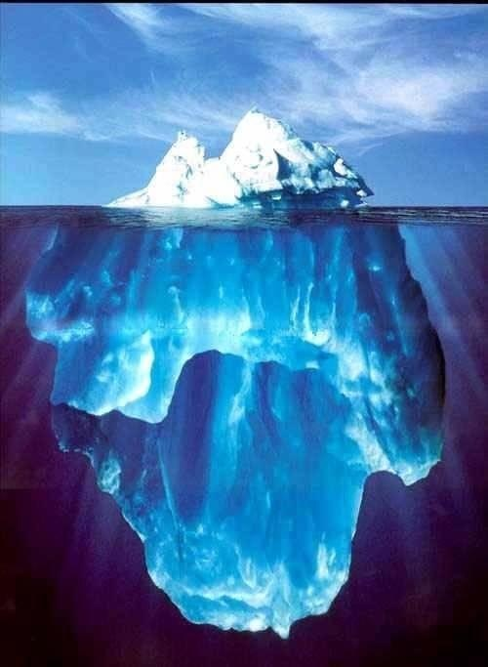
Imperative 3—Mind the Iceberg
SMEs and Job Creation
Job creation contribution by type of firm
Source: SMEs Across the Globe, Ayyagarri, Beck, Dimurguc, World Bank, 2003; Formal SMEs have between 3-100 employees and pay all applicable taxes and hold relevant licences. Large firms are those with >100 employees.

Slide 14
Imperative 3—Mind the Iceberg
Build strong clusters – Cameroon Wood Cluster
Academic + R&D institutions and worker organizations
Groupements de l’industrie
Wood certification
Wood drying
Wood Promotion Center(CPB), CCIMA
Packaging materials
Distributors and importers of related equipment
Logistics companies and transporters
Camroonian Wood Cooperative, Union of Loggers
Transport services
Trading and distribution companies
Secondary Processing (2TB)
Local, regional & national exhibition spaces
Financial services
Tertiary Processing (3TB)
Electricity
Retail shops
Textile and finishing clusters
Specialized shops
Government Agencies & Ministries
Donors & NGOs
International trade shows
MINEPAT, local governments, Ministry of Forests and Wildlife
Logging: UFA, Forêts communautaires,.
Not developed
Needs improvement
Sawmills (PP)
World Bank, EU, FAO, UNDP, IMF, SNV, WWF, Global Witness
Competitive
Related clusters

Slide 15
Imperative 3—Change Mindsets
Escaping the Survival Trap
Mindset
Operating Reality
Actions
Results

Slide 16
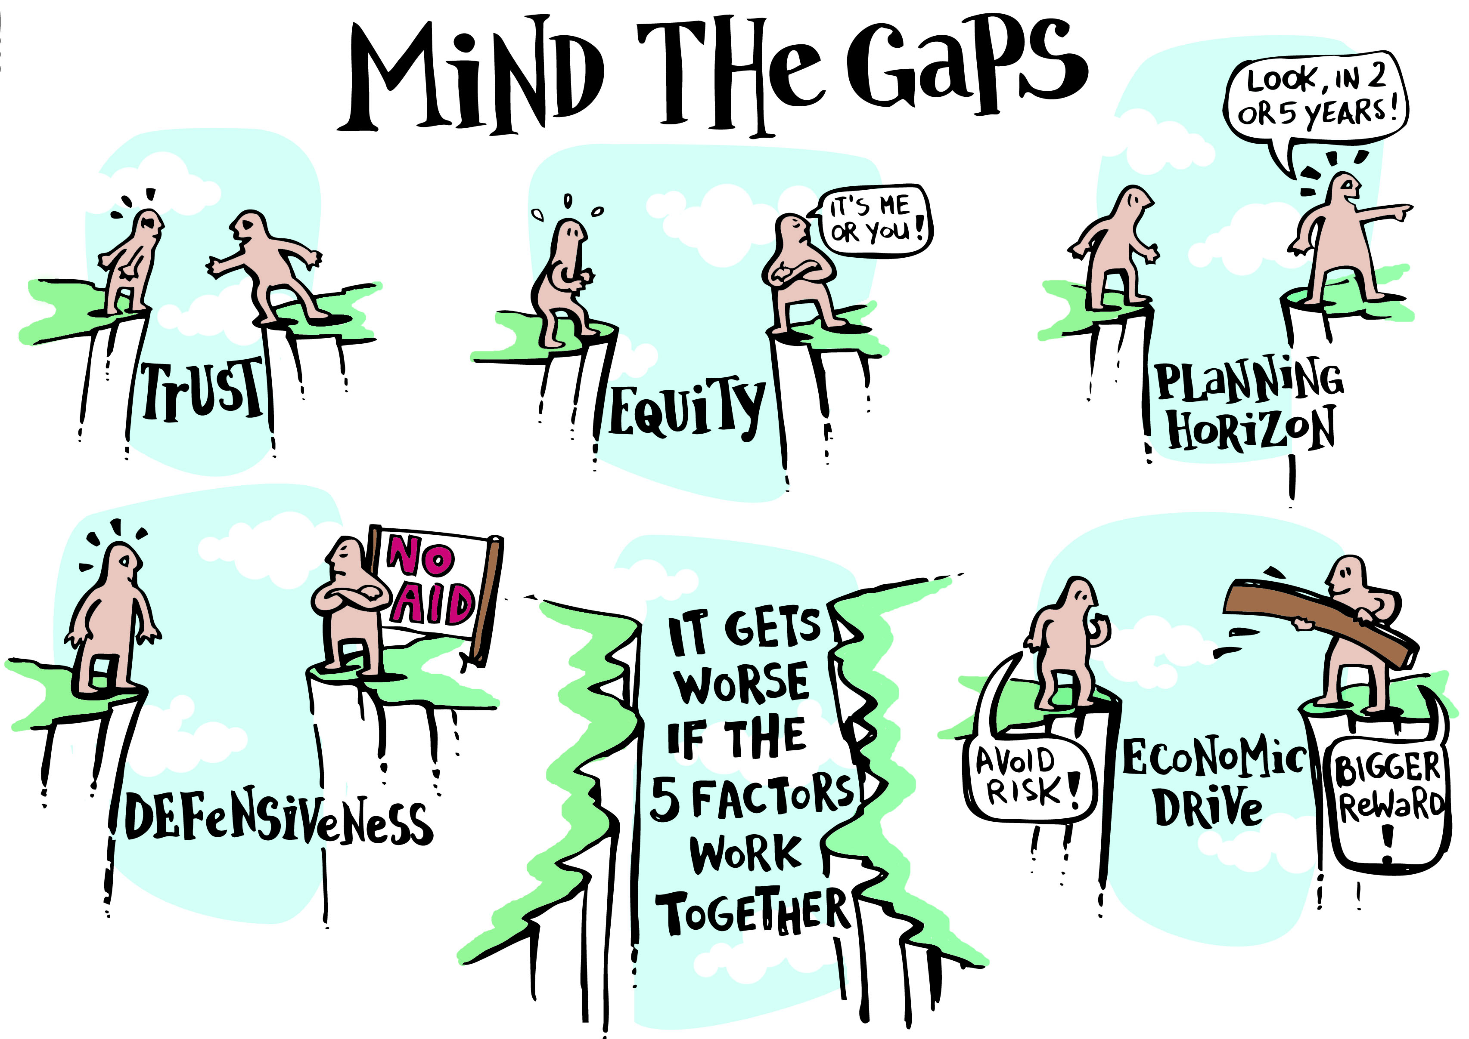
Imperative 3—Change Mindsets
Mind the Gaps

Slide 17
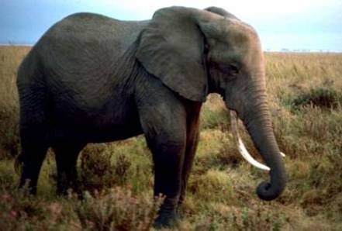
Imperative 5—Collaborate to Compete
An African Metaphor

Slide 18
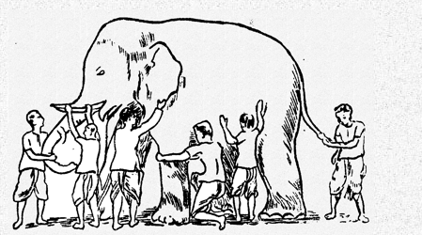
Imperative 5—Collaborate to Compete
Embracing Economic Transformation

Slide 19
From Potential to Prosperity
Is Suriname Ready for its Metamorphosis?
Tension
Moral Purpose
Leadership
Receptivity
Knowledge

Slide 20
Conclusion + Q&A
THANK YOU!
Eric Kacou
Co-Founder & CEO, ESPartners
Cote d’Ivoire: +22559498434
Rwanda: +250788303063
ekacou@espartners.co

