Slide 1
From Potential to Prosperity
Five Imperatives for Transforming Suriname’s Economy
2nd Competitiveness Forum Suriname
March 12th, 2015

Slide 2
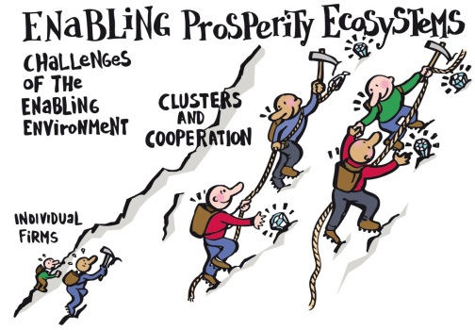
About ESPartners
Entrepreneurial Solutions for Prosperity
What we offer
Relevant Experience
Intelligent Capital™
Prosperity Ecosystem™
Archimedean Leadership™

Slide 3
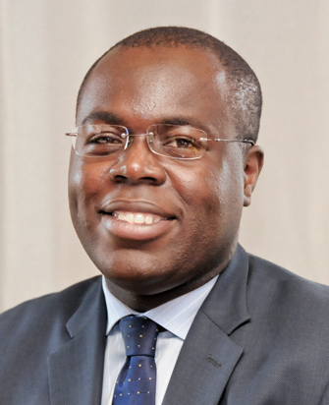
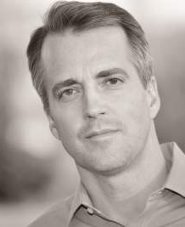
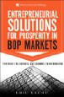
ESPartners’ Experience
We have collaborated with 15+ clients in 20+ countries
Selection of Experience Sectors & Clusters
Agri-business Financial Services Petro Chemical Dried Fruits & Nuts Forestry Products Aquaculture Artisanal Tourism Pisciculture Wealth Management | Horticulture NTIC Distribution Sugar Textile Manufacturing Distribution Events & Music
Selected Team
Eric Kacou
Co-founder & CEO
Rob Henning
Co-founder & Partner
Selection of Experience: Countries
Côte d’Ivoire Rwanda Burundi Congo Cameroon Gabon Mali Angola South Soudan South Africa | Nigeria Haiti Afghanistan Bermuda Jamaica Trinidad Bangladesh USA Canada France
Intellectual Foundations

Slide 4
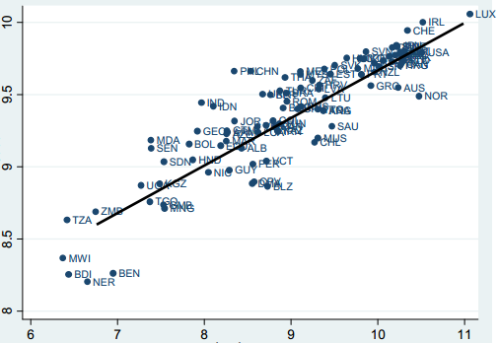
Products and Prosperity
“We are what we export”
Correlation between the complexity of the export basket (Log EXPY) and per capita GDP
Complexity of the export basket (Log EXPY)
GDP per capita (log GDP PPP)
Note: En abcisse, le log. du PIB réel per capita (PPP) et en ordonnée le log. de l’indicateur EXPY (PPP). Source: HAUSSMANN

Slide 5
Transforming Potential into Prosperity
What is the Next Stage in Suriname’s Economic Transformation
Private Sector Leadership
High
Build a platform for core processes and products
Choosing Customers and Markets
Defining Distribution Channels
Investing in Employees
Sell Products
ECONOMIC LEADERSHIP
Stable Macroeconomic environment
Rule of law
Allocation of Resources
Exploit Raw Materials and Cheap Goods
Government Leadership
Low
Low
High
ABILITY OF THE ECONOMY TO SUSTAIN COMPLEX RELATIONSHIPS
Physical Capital
Social Capital

Slide 6
A Successful Metamorphosis
The origin of Butterflies

Slide 7
From Potential to Prosperity
Five Imperatives for Econmic Transformation
Embrace National Change
Build Great Products through Clusters
Mind the Iceberg
Escape the Survival Trap
Collaborate to Compete

Slide 8
Imperative 1—Embrace National Change
Rwanda Vision 2020
Rwanda GDP Objectives 2000- 2020
GDP Growth
Rwanda’s economy will need to grow 7-fold in order to reach Vision 2020 $900 per capita income
2020 GDP is $14.4 Bn
Rwandan Population (000)
2000 GDP is $2 Bn
Population Growth
$900 per cap
Most demographic forecasts assume a continued annual growth rate of 2.5-3% in the next 20 years
At that growth rate, Rwanda's population will double to 16 million by 2020
Despite possibilities to influence family planning, economic objectives should assume higher-end demographic projections
$250
$900

Slide 9
Imperative 1—Embrace National Change
Mindsets, Clusters and Partnership
Mental Models
Strengthen competitiveness culture
National, industry-wide, or firm-level surveys to understand leaders’ attitudes towards competitiveness
Communication campaign to address leaders’ attitudes about competitiveness-includes seminars, workshops, presentations, books & articles, lectures
Shared competitive mindsets and sound macroeconomic environment
Cluster Strategies
Build competitiveness of key industries / clusters
Identify key industries / clusters
Apply 5-step process to develop cluster strategies and plans
Quantify costs and returns of competitiveness strategies
Draw operating plans and assist implementation
Transform domestic economy’s performance by building the competitiveness of wealth-creating Industries / clusters
Objectives
Public-Private
Partnership
Enterprise
Development
Build companies’ internal capacity
Government Support
Strengthen enabling environment for private enterprise
Activities
Results

Slide 10
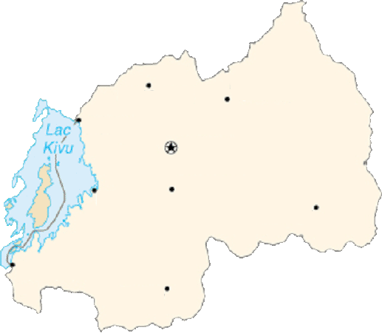
Imperative 2—Build Great Products through Clusters
High value and low impact Primate Experience
Rwanda’s Product to Eco-travelers
“The Primate Certification Course” Experience
Who are the Eco-travelers?
Seasoned travelers, Eco-travelers travel the world looking to experience life-defining nature-based activities with a strong scientific ‘feel’. Instead of thinking about a specific country, Eco-travelers select from an activity menu to construct their trip around some of world’s rarest natural species and sites. Prior to the trip, they spend significant time researching both the attraction and the destination. Although interested in the occasional “adrenalin rush” experience, Eco-travelers want to travel in totally safety. They also want to add texture to their magazine or book based on knowledge about the species they are interested in—the more sights, sounds and smells, the better! This mix of needs make Eco-travelers look for fully insured tour companies operating high quality equipment and great guiding and interpretive services. Ecologically and culturally sensitive, Eco-travelers want to be “non-intrusive” and leave nature intact. Therefore, Eco-travelers seek comfortable lodges to stay in communion with nature
Day 6-8— Ruhengeri
Meet Diane Fossey scientist at Karisoke camp, and have quick orientation session
Spend night at community-run lodge- 1st trek in the morning- class in the afternoon
Intore dance at night- 2nd trek in the morning- departure in the afternon
Day 5-6 — Kibuye - Gisenyi
Travel to Kibuye by boat—lunch, afternoon at the spa, night at the guest house
Travel to Gisenyi by boat- lunch, visit local farms, and travel by road to Ruhengeri
Ruhengeri
Byumba
Gisenyi
KIGALI
Day 1— Kigali Arrival
Meet certified guides
Go through visit schedule
Reading material handed out
Kibuye
Kibungo
Nyanza King Palace
Cyangugu
Day 2 & 4—Nyungwe
Travel to Nyungwe- safety, food, dress code tips
Stay at great local lodge, classes, and treks through the forest to see chimps, baboons, and other rare species
Butare
National Museum

Slide 11
Imperative 2—Build Great Products through Clusters
The 5-Step Process
Step 1
Step 2
Step 3
Step 4
Step 5
Analyze Current Situation
Set Industry Objectives
Understand Customer Needs
Articulate Competitive Positioning
Develop Action Guidelines
Formation and Ongoing Participation of the Cluster Workgroup

Slide 12
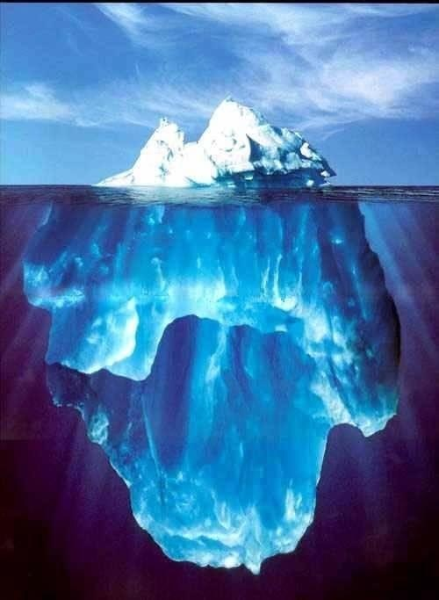
Imperative 3—Mind the Iceberg
SMEs and Job Creation
Job creation contribution by type of firm
Source: SMEs Across the Globe, Ayyagarri, Beck, Dimurguc, World Bank, 2003; Formal SMEs have between 3-100 employees and pay all applicable taxes and hold relevant licences. Large firms are those with >100 employees.

Slide 13
Imperative 3—Mind the Iceberg
Build strong clusters – Cameroon Wood Cluster
Academic + R&D institutions and worker organizations
Groupements de l’industrie
Wood certification
Wood drying
Wood Promotion Center(CPB), CCIMA
Packaging materials
Distributors and importers of related equipment
Logistics companies and transporters
Camroonian Wood Cooperative, Union of Loggers
Transport services
Trading and distribution companies
Secondary Processing (2TB)
Local, regional & national exhibition spaces
Financial services
Tertiary Processing (3TB)
Electricity
Retail shops
Textile and finishing clusters
Specialized shops
Government Agencies & Ministries
Donors & NGOs
International trade shows
MINEPAT, local governments, Ministry of Forests and Wildlife
Logging: UFA, Forêts communautaires,.
Not developed
Needs improvement
Sawmills (PP)
World Bank, EU, FAO, UNDP, IMF, SNV, WWF, Global Witness
Competitive
Related clusters

Slide 14
Imperative 3—Escape the Survival Trap
Revisiting our daily struggle
Mindset
Operating Reality
Actions
Results

Slide 15
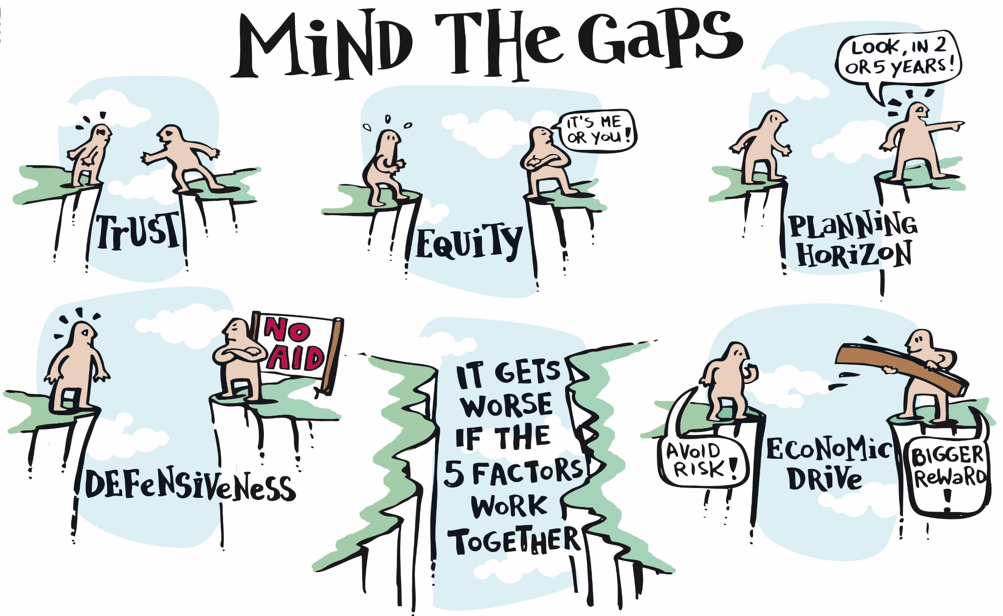
Imperative 3—Escape the Survival Trap
Mind the Gaps

Slide 16
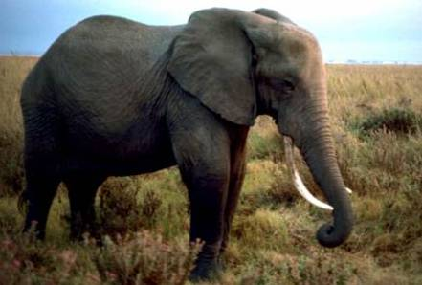
Imperative 5—Collaborate to Compete
An African Metaphor

Slide 17
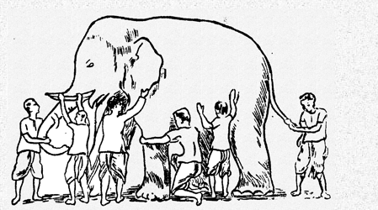
Imperative 5—Collaborate to Compete
Embracing Economic Transformation

Slide 18
From Potential to Prosperity
Is Suriname Ready for its Metamorphosis?
Tension
Moral Purpose
Leadership
Receptivity
Knowledge

Slide 19
Conclusion + Q&A
THANK YOU!
Eric Kacou
Co-Founder & CEO, ESPartners
Cote d’Ivoire: +22559498434
Rwanda: +250788303063
ekacou@espartners.co
@eric_kacou

