Slide 1
Economic Growth, Productivity & Competitiveness in Suriname
What is to be Done?

Slide 2
Suriname is leaving its comparators behind and has stronger policy buffers.
Moving away from low growth/low income towards higher growth/higher income.
Coming out of the “most severe recession since the Great Depression”, Suriname is better prepared to face external shocks and has improved policy buffers:
  Lowered public debt and obtained prudent fiscal balance
  Increased foreign reserves and a stable exchange rate
  Decreased inflation
Economic growth is high.
Could things be better?

Slide 3
Economic growth is high but a worrying history and falling behind ROSE (rest of small economies i.e. population less than 3 million).
Falling behind ROSE
Forward to the past
(in 2010 GDP pc is the same as in 1977)
Old GDP series

Slide 4
High growth but does the source of growth matter?
Economic growth equals inputs (investment & labour) plus total factor productivity
Total factor productivity, TFP, is a means of getting something for nothing, i.e. economic growth over and beyond inputs (labour and capital).
Empirical cross-country evidence suggests that sustained high growth is more based on TFP growth than input growth.
Suriname’s recent economic growth is due more to inputs than to total factor productivity.

Slide 5
Investment is not a problem relative to ROSE (ratios of gross capital formation to GDP)

Slide 6
Relative population growth, maybe?

Slide 7
But total factor productivity is a problem.
TFP has again begun to fall
Relative TFP is increasingly lower than comparators (less than unity)
Source: Kamau 2012

Slide 8
Total factor productivity at the firm level is low (negative).
Suriname’s firms are the least productive (but have a higher dispersion) in the Caribbean.
Source: Kamau 2012

Slide 9
. . . and labour productivity is lower than ROSE.
Relative to ROSE at enterprise level (sales per worker)
Country level (output per employee per hour)
Unknown/data
Source: Enterprise survey 2010

Slide 10
Why is there low productivity?
Is competitiveness the problem?

Slide 11
A country’s international competitiveness is typically measured by:
The Real Exchange Rate which in combination with domestic economic policies achieve internal and external balance. An appreciation of the real exchange rate is a loss while a depreciation an improvement in international competitiveness.
Business Strategist approach is based on four interrelated factors: firm strategy, structure and rivalry, demand conditions, related supporting industries and factor conditions (e.g. skilled labour, capital and infrastructure). The government is a facilitator encouraging firms to become competitive and creating the environment that enables firms to increase productivity and become competitive. Typically measured by the World Economic Forum Index & Doing Business.
Technology and Innovation approach that is the introduction of new products and technologies through joint ventures, new licencing agreements, intra-firm organizational changes, and opening new plants, that is new-to-firm innovation.

Slide 12
Competitiveness as measured by the real exchange rate: not a problem.
The 20 percent devaluation in January 2011 is likely to have placed the current exchange rate within the equilibrium band.
The exchange rate is broadly in line with medium-term macroeconomic fundamentals
IMF Article IV 2012

Slide 13
International Competitiveness:
A Business Strategist approach

Slide 14
Not so competitive: large gaps relative to ROSE (less than unity=worse)
Shortfalls in practically all of the competitiveness dimensions except health and primary education.

Slide 15
Worse institutions relative to ROSE opinions of business executives (less than unity=worse)
Lower trust and higher unproductive rent seeking activities relative to ROSE.
Source: World Economic Forum 2012

Slide 16
Government services could be better for business (relative to ROSE)
Source: Doing Business 2012, WB

Slide 17
Complaints by formal sector businesses (relative to ROSE)
Suriname businessmen complain more about:
Quality of workforce
Customs and trade regulation,
Competition from informal firms
Access to land
Crime and theft
Licensing and permits
Corruption
Access to finance
Source: Enterprise Survey 2010, formal firms

Slide 18
Example: no crime and theft: productivity almost doubles
Enterprise Survey 2010, formal firms

Slide 19
Macroeconomic Environment

Slide 20
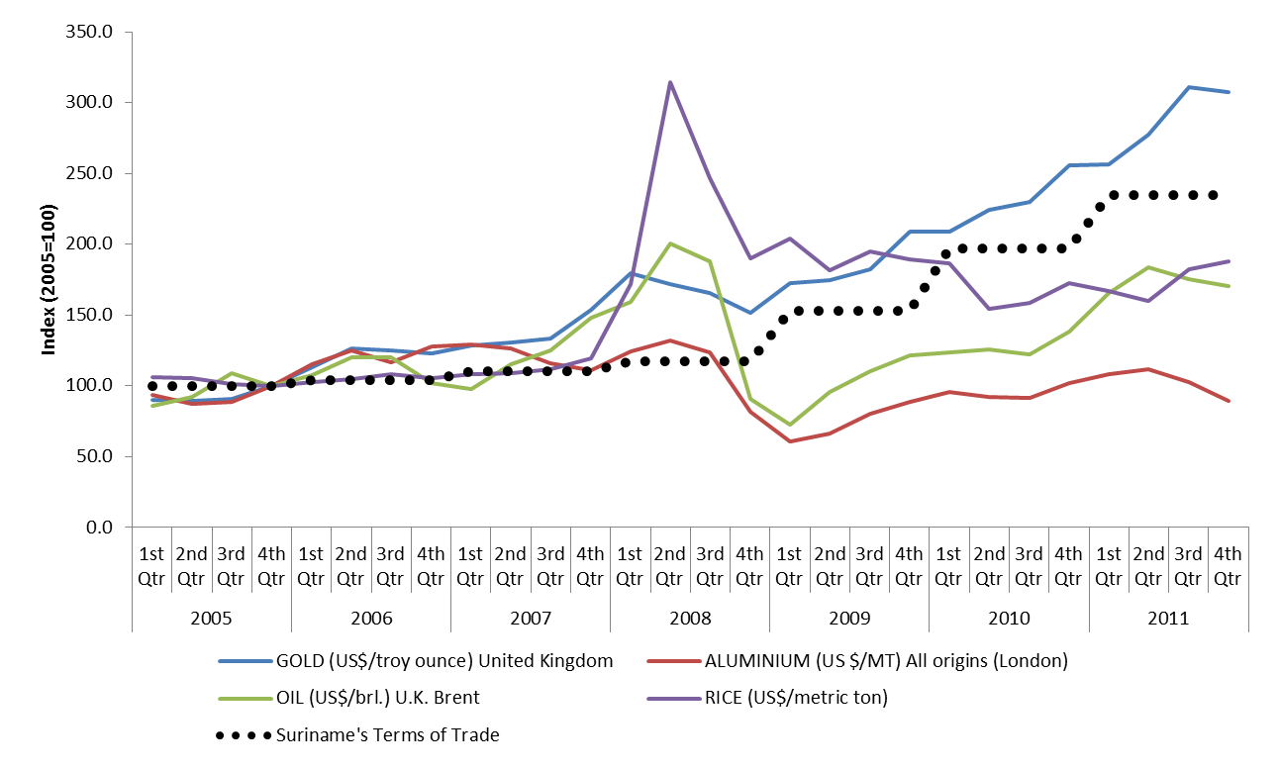
Recently, Suriname had good luck, thanks to gold.
Source: Kamau 2012

Slide 21
Luck could disappear, as in the past.
External shocks were worse (level & volatility) than ROSE.
External shocks. The combined effects of contemporaneous external shocks include shocks to trade , remittances (remit), direct foreign investment and service exports (xs)

Slide 22
What happens if luck runs out?
Positive: A 1 percent increase in gold prices raises Suriname’s real GDP by almost 0.04 percentage points, although the effect is gradual (after 8-10 years), it is permanent.
Positive: A 1 percent increase in the EU’s GDP raises Suriname’s GDP initially by 0.011 percentage points, but the impact is only temporary, and has hardly no effect after 8 years

Slide 23
But Suriname has good policy buffers so can adopt countercyclical policy.
Fiscal and Debt
Current account and Foreign Reserves
g

Slide 24
What is to be done?

Slide 25
Maintaining a sound macroeconomic environment
Reform towards a level playing field
Active promotion of development

Slide 26
A sound macroeconomic environment
  Keep her steady as she goes

Slide 27
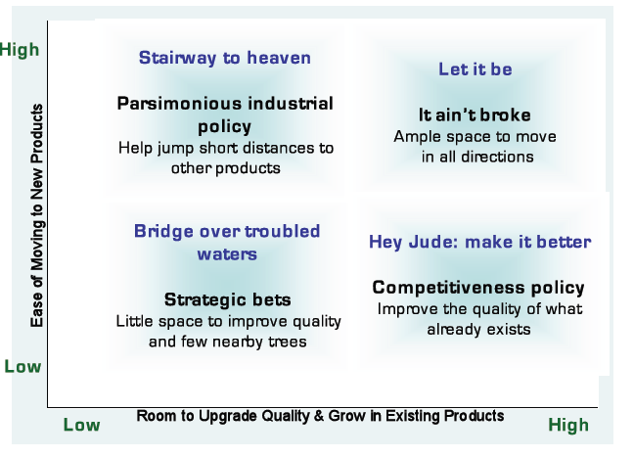
Level playing field vs. active development policy
“Countries seldom grow rich by producing the same things more productively. They usually change what they produce. . .new economic activities that are more productive and thus are able to pay higher wages.”
Haussmann and Klinger 2009
Active development policy
Level playing field

Slide 28
A level playing field with international competitors: improve the quality of what already exists
Strengthen public institutions to obtain trust and to reduce unproductive rent seeking.
Improve public services by reducing cost and time of doing business.
Through:
  e-Government
  Single Window/One Stop Shops, etc. decentralised

Slide 29

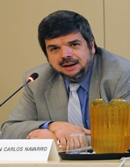
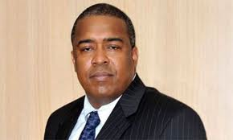
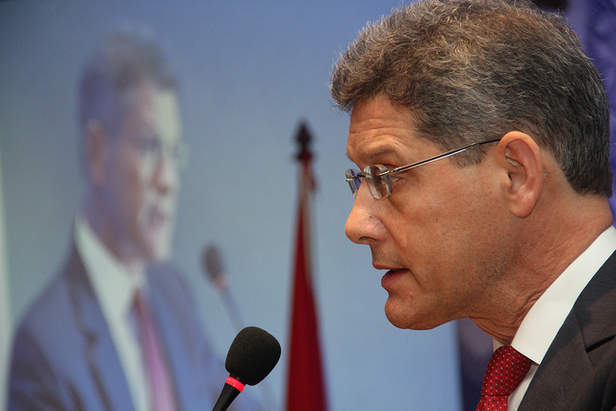

An active development policy
Policies to encourage new-to-firm innovation; help jump short distances to other products-processes
  Tax breaks
  Public-Private Partnerships
  Innovation Funds
  Match maker between local and foreign firms
  Education and skills up to par with the needs of an innovative firm (in industry/agriculture/services)
  Expand the percentage of Surinamese ideas that are bankable
  Facilitate economies of scale through clusters
  Create competitive districts

Slide 30
But, in Suriname we know very little about.
New-to-firm innovation : what are the constraints?
Beveridge curve, i.e. the match between the profile of labour demanded and supplied today and tomorrow: education and training?
Household labour supply : what are the constraints?
Reducing crime and under-employment by encouraging youth business start up & training (between school and work)

Slide 31


However, at all costs, avoid wholesale imported recipes! But, tailor policies for Suriname. To do so:
Eliminate information gaps to obtain evidence-based policy and programs.
Systematic, comprehensive public-private dialogue to determine priorities and action plans.
In both tasks, IDB could support the Suriname’s agenda:
  Finance surveys (labour market assessment, new-to-firm innovation enterprise surveys, crime, etc.).
  Compete Caribbean to finance Suriname Business Forum (through the Caribbean Growth Forum) to set up public-private civic working groups to develop action plans followed by a second stage of support in implementation.
  Other possible support discussed tomorrow.

Slide 32
Success in increasing productivity could lead to a leap forward (by reaching productivity levels of ROSE)
Becoming a ROSE
US$20,209
US$16,415
US$13,291

Slide 33
That is we should keep in mind that all of this does not mean very much. . .
“. . . until the Surinamese can feel the difference in their pockets.”
Desi Bouterse [paraphrased]
July 2012

Slide 34


