Slide 1
Benefitting from your COPYRIGHT and Using Copyright Works of Others in Your Business
Carol Simpson
Head, Caribbean Section, Regional Bureau for Latin America and the Caribbean, WIPO

Slide 2
Introduction
What is the issue?
Copyright = IP
IP = Capital
Capital = Economic Development
Why is it important to us?
Copyright protects only original works
Works are protected from the moment of their creation
Copyright protects both analogical and digital works
Hope do we benefit?
The Copyrighted works benefit Creativity and Creativity benefits Economic growth

Slide 3
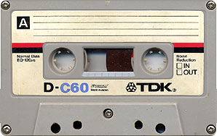
Copyright Protected Works
literary works – words spoken or sung, written
material, including tables, computer programmes;
dramatic works - scripts, dance and mimes;
musical works - scores or other notations (lyrics
are protected as literary works);
artistic works - paintings, sculptures, technical
drawings, photographs, diagrams and buildings;
films, broadcast and cable programmes –visual
images;
sound recordings - any analogue, digital, or
electronic recording;
typographical arrangements of published
editions

Slide 4
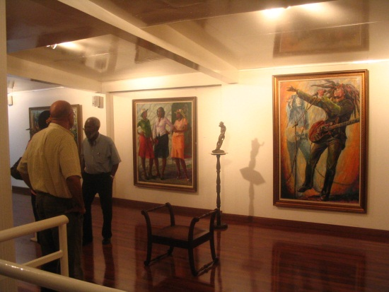
EXCLUSIVE RIGHTS
The creators of works protected by copyright and their heirs have certain basic rights. They have an exclusive right to use or authorize others to use the work on agreed terms. The Copyright holder can prohibit or authorize the use of the work

Slide 5
Two types of rights
Economic Rights
Compensation for work
Authorize or prohibit use
Moral Rights
To object to uses of his/her work
Right to be named as the creator

Slide 6
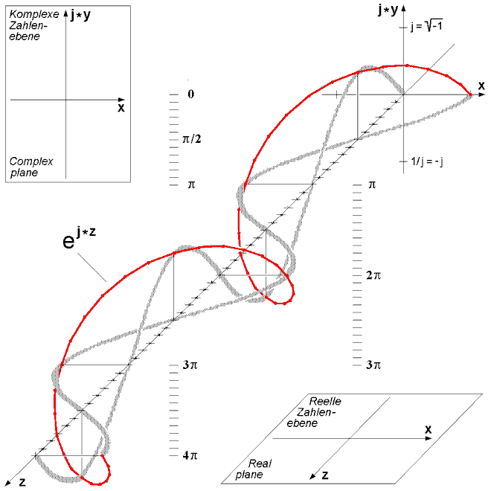
Protection
Extends only to expressions
Does not extend to ideas, procedures, news of the day, methods of operation or mathematical concepts
Stock image: MS PowerPoint clip art

Slide 7
Copyright Requires NO formal Registration
Copyright unlike the Trademark and Patent systems, carries no formal registration system.

Slide 8
As long as a protected work is fixed in a Tangible form or Material form it immediately/automatically attracts Copyright protection, without any formalities like registration.

Slide 9
Duration of Copyright
Copyright in a work lasts for the author’s lifetime plus 50 years from the end of the calendar year in which the author dies
Minimum Level under Berne Convention
Life + 50 years
Additionally
Life + 70
Life + 95

Slide 10
Copyright Notice
It is not mandatory to put the notice on your work to be protected
But it is strongly recommended to remind people that the work is copyrighted and identifies the copyright owner
The word “copyright” or the copyright symbol “©”;
The year in which the work was first published;
The name of the copyright owner; and
The words “All Rights Reserved”

Slide 11
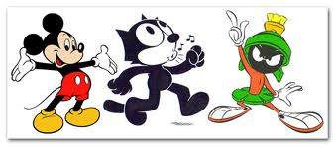
Collective Management of Rights
Collective licensing of copyright works, representing composers, authors, publishers, producers
CISAC – music IFRRO – literary
Association of Caribbean Collecting Societies, ACCS
COSCAP – Barbados
JACAP, JAMMS, JAMCOPY – Jamaica
ECCO – Eastern Caribbean Copyright Organisation

Slide 12
4- Using Copyright Works Owned by Others
WHEN do you need permission?
Work is covered by copyright/related rights +
Use implies an exclusive right
+
Use is not covered by limitation/exception

Slide 13
Fair Dealing
"Fair dealing“, one may reproduce the
copyrighted work for a limited purpose of :-
research or private study
criticism and review
reporting current events
"Fair dealing" is determined on a case by case basis and looks at why the work was used, how much of the work was used, the type of work that was used and the effect of that use on the potential market or commercial value of the work.

Slide 14
Process to get a permission
First Step:
Clarify if the work is protected
Use of copyright notice or
Search in the registrar/agencies
Ministry of Culture

Slide 15
Second Step:
Identify the copyright owner
Contact publishers, record producers, distributors

Slide 16
Third Step:
Negotiation and conclusion of licensing agreement
Key points: scope, remuneration, precise terms and conditions of use

Slide 17
The Legal Framework for Copyright Protection
International Instruments:
The Berne Convention for the Protection of Literary and Artistic Works
Convention for the Protection of Performers, Producers of Phonograms and Broadcasting Organizations - Rome Convention
WIPO Copyright Treaty
WIPO Performances and Phonograms Treaty
Beijing Treaty on Audiovisual Performances
Marrakesh Treaty to Facilitate Access to Published Works for Persons Who Are Blind, Visually Impaired or Otherwise Print Disabled

Slide 18
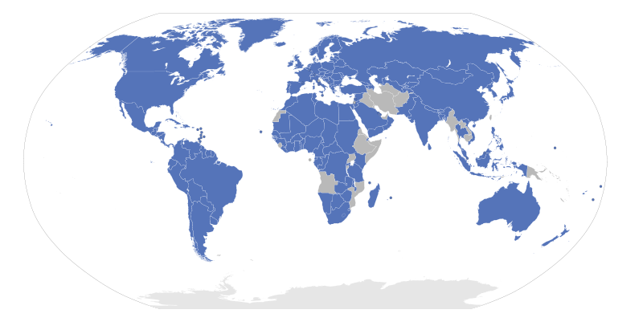
Berne Convention Members: 166 countries

Slide 19
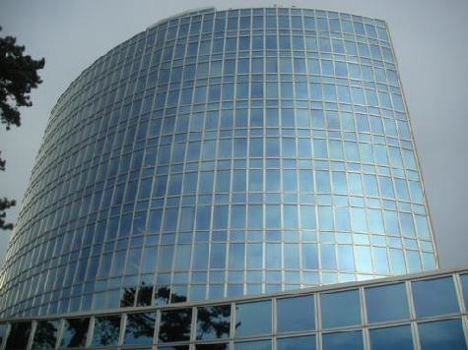
THANK YOU!!!!!!
For more information visit: www.wipo.int

