Slide 1

SIMAPRO
Improving Efficiency, Quality and Working Conditions in the Chilean Agro-industry
(Fruit Export)

Slide 2

SIMAPRO
System for Integrated Measurement and Advance of Productivity

Slide 3

Background:
31% of $ 10.8 billion Chilean Agriculture Export
1.5 % National GDP
Export: 100 countries (USA-Europe 70%)
Grapes, apples, kiwis, pears, avocados and 70 others….
Global traders: Dole, Del Monte, Chiquita
Employment: 450.000; Temporally: 300.00; Women 53%
Training: 30% received– same as 2001; temporally workers albeit excluded
Injuries rate: 5% - not improved since 2001
Social Dialogue from 2007

Slide 4
Challenges:
Appreciation Peso
Cost increase:
Energy, Transportation
Labor
Increase competition:
New players (L America, Africa)
Integral Productivity Enhancement:
Deficient Working Conditions and Labor Relations:
Labor shortage; prefer to employ elsewhere
Requirement of International Standards
HACCP; GMP; Global GAP; Tesco Nature Choice, CSR; Carbon and Water Footprint
Competency Based Training / SIMAPRO

Slide 5

SIMAPRO-MODEL
BLENDING OF INFORMAL AND (non) FORMAL LEARNING
SOCIAL DIALOGUE
Efficiency, Quality, Flexibility, Design, Compliances
ORGANIZATIONAL
OBJECTIVES
Decent Work
Integrated Measurement of Indicators
MONITORING
Feedback + Microtraining MEETINGS
STAG
(competency based self training and assessment guides)
FACILITATORS:
Line Managers
IMPROVEMENTS

Slide 6
1. STAG: Self Training and Assessment Guide
Index:
1. Self Assessment
2. Explication
3. Assessment
Tailoring: Mass Customization

Slide 7
2. Measurement and Group-Feedback
Indicators
1. Process: Volume, Quality
2. Social: H&S, Absenteeism, Communication
Anchors Points Effectiveness:
+100; 0; -100

Slide 8
SIMAPRO CHILE: 2007-2010
Year | N° New Firms | N° Workers Trained*
2007 | 2 | 210
III Región
IV Región
V región
Región Metropolitana
VI Región
VII Región
2008 | 2 | 795
2009 | 10 | 1044
2010 | 6 | 690
Total | 20 | 2739
* Inlcuding supervisors

Slide 9
SIMAPRO CHILE: Bottom-up Improvement Proposals
APPLICATION STAG
2007-2011 (March)
+/-
20 PROPOSALS PER FIRM
50 % Technical-Process Issues
330 REGISTRED PROPOSALS FROM WORKERS
12 PROPOSALS PER 100 WORKERS TRAINED
50 % Decent Work Issues

Slide 10
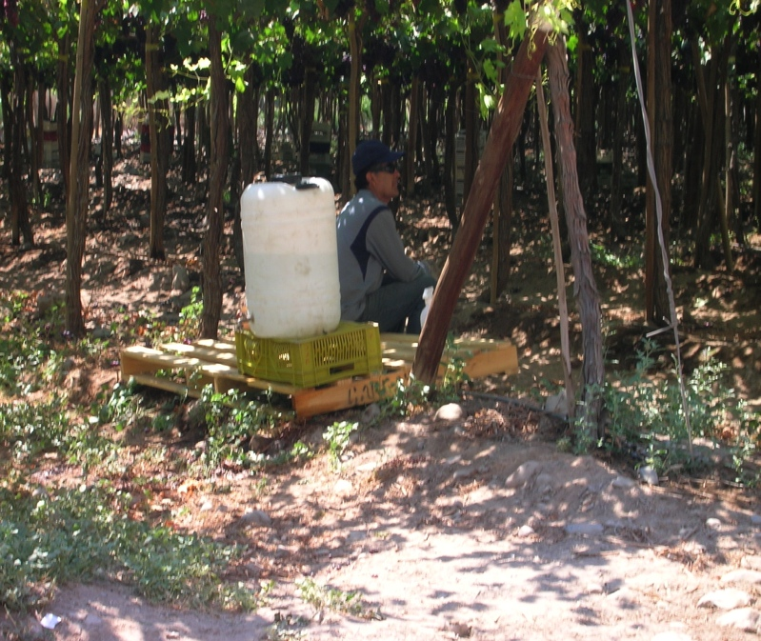
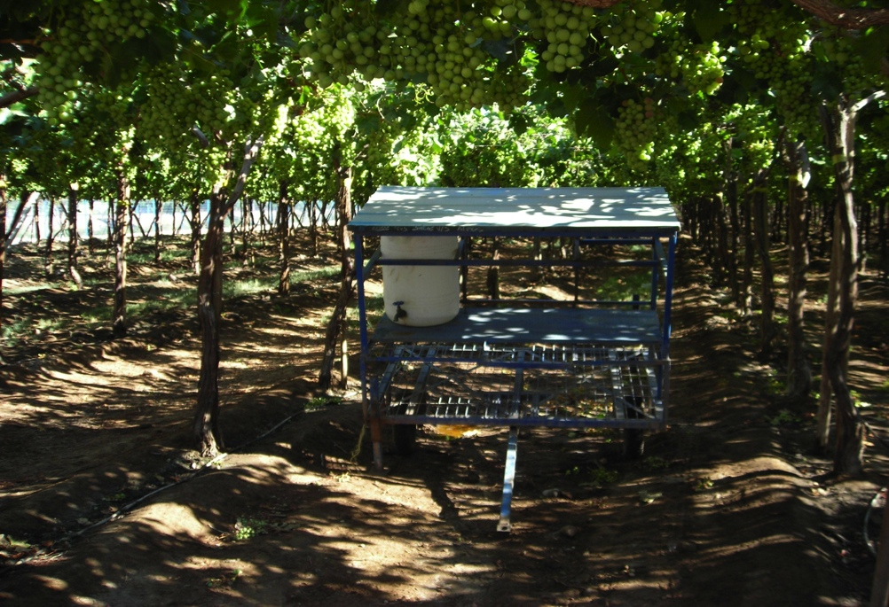
SIMAPRO CHILE: Bottom-up Improvement Proposals
EXAMPLES
AFTER
BEFORE
BEFORE: FRESH WATER JERICAN HEATED DURING DAY (35+ Cº), ON THE SOIL AND NOT REFILLED
AFTER: FRESH WATER JERICAN COVERED, EASY TO MOVE, ELEVATED FROM SOIL AND REFILLED 2X DAY

Slide 11
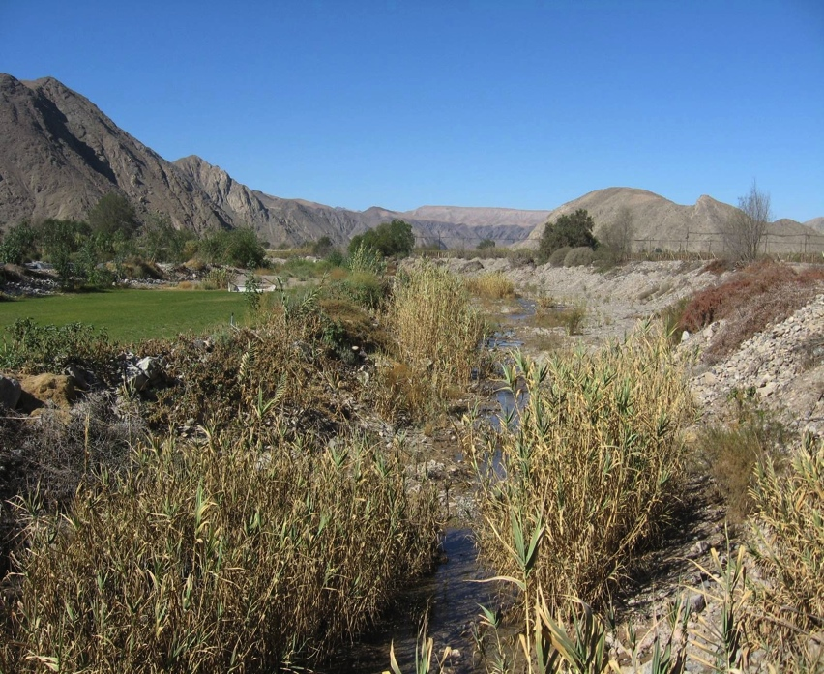
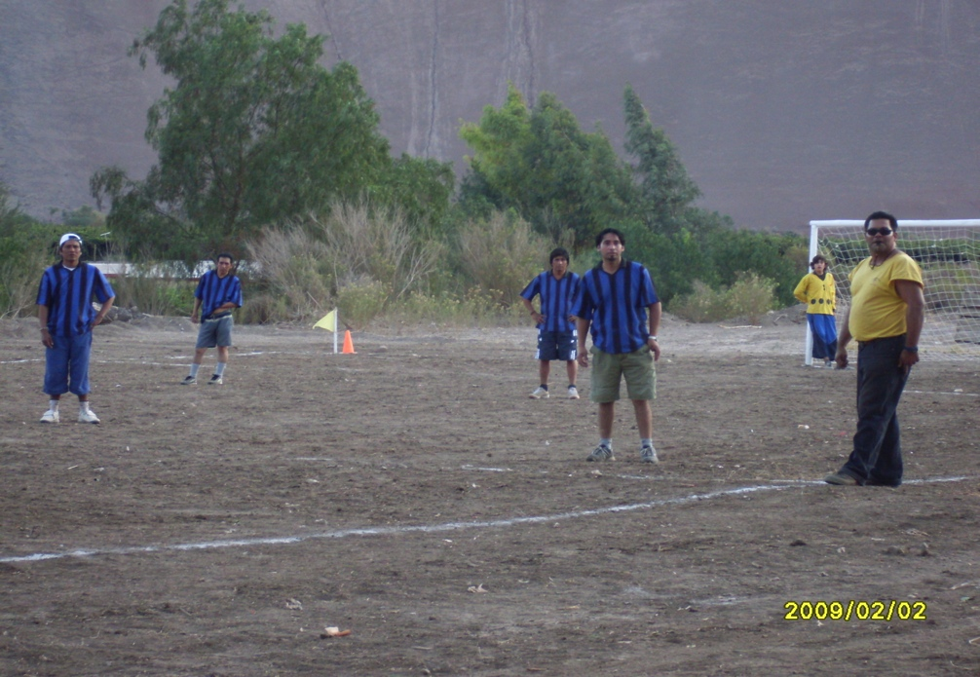
SIMAPRO CHILE: Bottom-up Improvement Proposals
EXAMPLES
AFTER
BEFORE
BEFORE: NO RECREATION FOR THE WORKERS AFTER WORK
AFTER: SPORT FACILITY FOR AFTER-WORK ACTIVITIES, REDUCING SOCIAL AND PSYCHOLOGICAL PROBLEMS AT THE CAMP.

Slide 12
SIMAPRO CHILE: Results (ROI - Phillips)
EXAMPLE ACONEX:
Level 4 ROI
28% improvement in indicators
Level 5 ROI:
82.6% Return on Investment
Increase in salary:
22%
Reduction Injury Rate by 14%-point

Slide 13
SIMAPRO CHILE: Implementation Strategy
ROLES
Social Dialogue Forum of the Sector
ILO Chile (DW-agenda)
Setting
Financing
National VTE System: SENCE, Social Scholarship
Ministries of Labor, Agriculture and CORFO
Sector Leaders
Employers Organization
ASOEX - AGROCAP
Operational Leaders
Multiplication: Training of 100 Consultants (2010)
Consultancy Firm INTERFASES
Initiators
Firms Applying SYMAPRO
Institutional building
Network of Firms and Institutions

Slide 14
CHALLENGES:
Overcome Employers resistance to invest in STAG-SIMAPRO
Enhance social dialogue
Up-scaling the application in the sector (training of consultants)
Cost reduction of editing tailored made STAG
Strengthen linkages with government pogrammes
Reinforce linkages with educational system (VT, universities)

Slide 15
RESOURCES
WWW.OIT.ORG.MX
WWW.CINTRFOR.ORG.UY
HTTP://competenciasazucar.ning.com
HTTP://simaproturismo.ning.com
HTTP://simaproautomotriz.ning.com
WWW.SIMAPRO.ORG
HTTP://NEW.SIMAPRO.CL
HTTP://WWW.PROMES.SE
http://vimeo.com/15063082

Slide 16
EXPERIENCES
SECTORS
COUNTRIES
SUGAR
MEXICO, CUBA, EL SALVADOR
TOURISM
MEXICO
AUTOMOTIVE
MEXICO
GARMENT
D.REPUBLIC
FRUIT
CHILE
MEXICO: STATES OF MORELOS, PUEBLA, SONORA
SME
HEALTH
SWEDEN

Slide 17
ACKNOWLEDGEMENTS:
Information was provided by:
Rodrigo López (AGROCAP)
Berta Rojas, Atonieta Palma, Hector Ojeda (INTERFASES)

