Slide 1
SIMAPRO
Phase 4:
Feedback and Training Capsules

Slide 2
Phases
Objectives, Baseline and Working Climate
Integration and Marathon of Improvement
Integrated Measurement
Feedback and Training Capsules
Core Competencies
Preparing STAG
Training of STAG-Facilitators
Competency Standard: National or Company
Training and Certification of Assessors
Assessment and Certification of Workers
Competency based Compensation
Results and Impact Assessment

Slide 3
SIMAPRO Management
Final Cycle Assessment:
Total Effectiveness x Shift
# Improvement Proposals
# Training themes
% Personal Participation
Start
Objectives
Indicators Definition
Goals (100, 0 y -100)
Measurement System
Feedback 1
Improvement Proposals
Training capsule
Feedback ...
.......
Indicators
Feedback 2
Verification - Application - Improves
New Improvement Proposals
Training Capsule
Feedback 4
.......
Feedback 3
...............

Slide 4
SIMAPRO Feedback Process
Main Process
Effectiveness
Measurements
Improvement Proposals
Objectives Achievement
Reflection
Application
Sub-Processes
(1)
(4)
Meeting preparation
Meeting facilitation
Evidence porfolio
(2)
(3)
Priorities
Training capsule
Reflection
Root cause
Proposals
People responsible and dates
(5)
Incentives

Slide 5
SUB-PROCESS 1:
PREPARATION OF THE FEEDBACK MEETING
Notes:
5

Slide 6
Sub Process: Preparation of the Feedback Meeting
Effectiveness
measurements
Daily
logbook
Precise observations in
the period
Preparation
Training capsule
Content for reflection at feedback meeting
Priorities
Analysis

Slide 7
PRIORITY ANALYSIS
Average
Period 2009
Absenteeism
Effectiveness
Number of faults
Shift
Shift
Shift

Slide 8
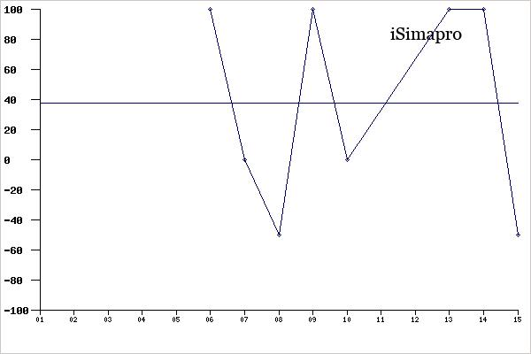
PRIORITY ANALYSIS
INDICATOR: USE OF PPE

Slide 9
TRAINING CAPSULE
COMPETENCIES MAP
For example…
VALUES
organization culture column
integrity, tolerance of failure
BASIC
fundamental
writing, numeracy, calculation, analysis
GENERIC
social, emotional, personality
communication, leadership, teamwork and analytic skills
TRANSVERSAL
general description and implementation of a quality system
process related
TECHNICAL
generate resistance calculations and parameters, welding techniques, sales techniques
regardless of a particular job
RESULTS
of impact, and coordinated with the enterprise vision
indicators of efficiency, quality, innovation, cost

Slide 11
Other tools for training capsules
Photos
Technical Drawing
Diagram
Video
Group Dynamic

Slide 12
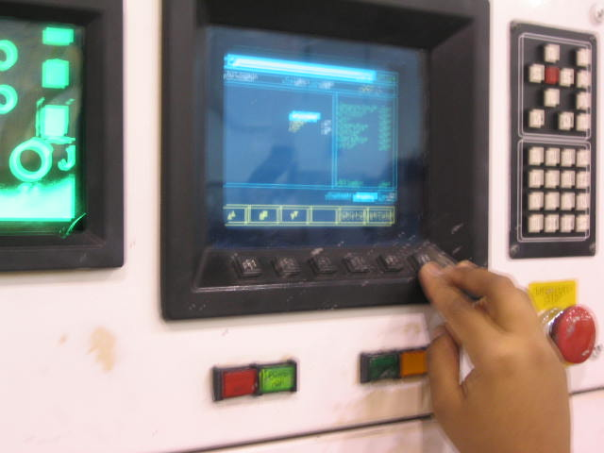
Photo

Slide 13
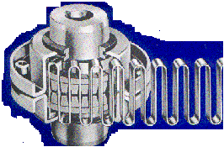
Technical Drawing

Slide 14
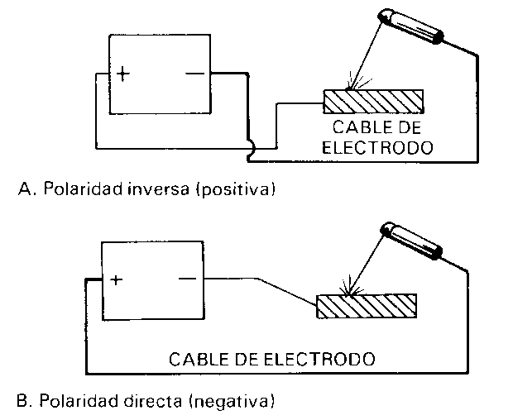
Diagram

Slide 16
Programme of Meetings
SIMAPRO Feedback Meetings
Date
Day
Francisco
Miguel
Genaro
25 January
14:00
12:30
12:30
8 February
12:30
14:00
12:30
22 February
12:30
12:30
14:00
8 March
14:00
12:30
12:30
22 March
12:30
14:00
12:30
5 April
12:30
12:30
14:00
19 April
14:00
12:30
12:30

Slide 17
SUB-PROCESS 2:
FACILITATION OF THE FEEDBACK MEETING
Notes:
17

Slide 18
Macro SIMAPRO Feedback Meeting
AGENDA
Welcome
Status Improvement Proposals
Measurement Results of Period
Training Capsule
Improvement Proposals
Closing

Slide 19
Sub-process 2: Facilitation of the feedback meeting

Slide 20
Sub-process 2: Facilitation of the feedback meeting
COMPONENTS
❶ REFLECTION
❷ ROOT CAUSE
❸ IMPROVEMENT PROPOSALS
❹ ALLOCATION TO PERSONS RESPONSIBLE

Slide 21
Sub-process 2: Facilitation of the feedback meeting
COMPONENT: REFLECTION
For example…
QUESTIONS
Stating the problem
What happened?
What did you see or feel?
What was the most important thing?
WHAT
Analysing the problem
Why is this important?
Why do you think it happened?
Why did you feel like that?
WHY
Generating an hypothesis and solution
HOW
How could you do the activity or carry out the task in another way?
Formulation of action
WHEN
WHAT
When and in what way would you use this new technique to carry out the task?

Slide 22
Visualization of Problems |  |  |  | Date:
 |  |  |  | Shift:
 |  |  |  | Area:
No. | PROBLEM AND ROOT CAUSE (WHAT) | SOLUTIONS (HOW) | RESPONSIBLE (WHO) | START AND FINISH DATES (WHEN) | RESOURCES USED (WHAT WITH) | EXPECTED AND REAL IMPACT (RESULT)
1
2
3
4
5
6

Slide 23
Results SIMAPRO: Cycle …

Slide 24
Sub-process 2: Facilitation of the feedback meeting
COMPONENT: IMPROVEMENT PROPOSALS
Base Model
COMPETENCY
+
RESULTS
=
PERFORMANCE
IMPROVEMENT
PROPOSALS
IMPLEMENTED
TOTAL AND PARTIAL EFFECTIVENESS
INTEGRAL EFFECTIVENESS
+
=
Process
Social
Implementation of SIMAPRO

Slide 25
Thank you

